Slide 1
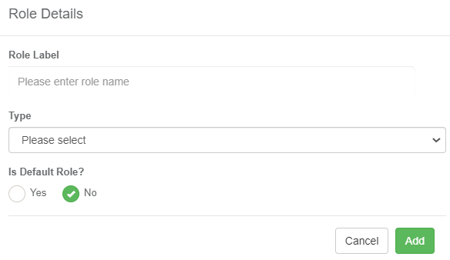
Adding a New Role Type
1. Select Role View
2. Select Add New Role Icon
3. Create role details. Default roles will automatically be assigned to new users.
4. Assign new users to role
5. Assign features
6. Edit role details
7. Delete Role

