Slide 1
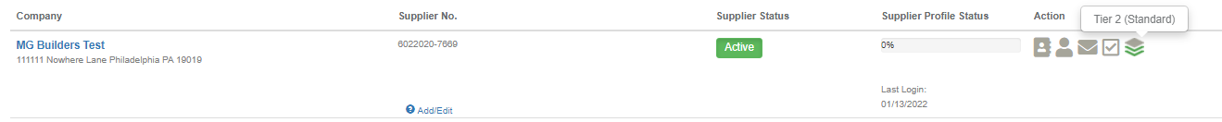

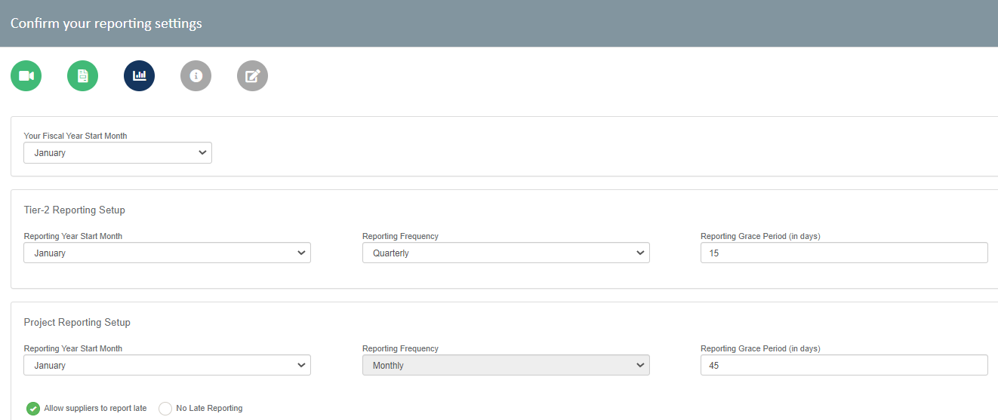
Setting up Tier-2
Identify Primes
Mark the vendor “Required to Report”
3. Confirm your Reporting periods under <Manage System Settings<Baseline Settings

